Slide 1
MGS 351 Final Project
Group 4:
Mehtab Anwar, Mi Jang,
Mitchel Victor, Zachary Wydysh

Slide 2
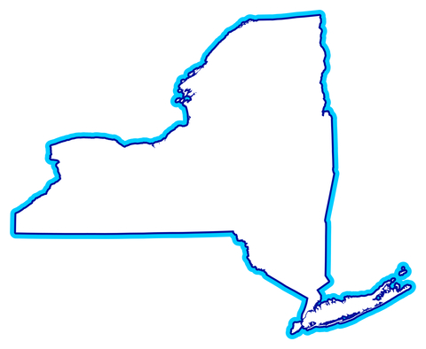
Background Of Project
Financial Trust Federal Credit Union
Local, Non for Profit financial institution
5 branches all over Western New York
Service anyone who lives, works or worships in Erie County
Offers a multitude of products and services
Notes:
Zachary

Slide 3
Business Problem/Opportunity and Identification of Business Value
Currently taking paper applications only
Time consuming
Highly disorganized
No recourse if lost
Difficult to analyze
Cluttered office space
Difficult to share information
Notes:
Mitch

Slide 4
Database Design Overview
Broken down into 4 tables
4 (1:M) relationships between tables
Multiple queries ran to form reports
Five reports to help analyze loan processing
Many macros to strengthen overall design
Notes:
Mi

Slide 5
User Interface Design
Switchboard guides user through database
Simplicity
Easy to navigate through forms
Reports are easily read
Can pull reports at any time
Macros run automatically
Consistency throughout database
Overall user friendly
Notes:
Mehtab

Slide 6
Project Demonstration
www.mgs351group4.weebly.com
Notes:
Zach

Slide 7
Conclusion
Developed a new, highly functional, user friendly set of operations
Will be learning curve
Will alter business practice for the better
Holds employees more accountable
Easier to track information
More efficient = potential increase in profit
Notes:
Mehab

Slide 8
The End

